Slide 1
02- Airflow concepts

Slide 2
What you will learn in this course 🧐🧐
You have successfully installed and configured Airflow. Now we can start working on our first DAG.
But first, we need to settle some terminology. We are going to discover:
Key concepts
Behind the scene
What Airflow is not

Slide 3
Key concepts
There are a few concepts you need to grasp before getting your hands dirty. We will give you the definition for each important terms you need to master.

Slide 4
DAG
At the center of everything in Airflow is the DAG or Directed Acyclic Graph. This is a collection of tasks you want to run in a certain order. For example, you want to:
Extract your data from database A with a SQL Command
Extract some other data from database B
Aggregate everything
Load the aggregated data into Redshift

Slide 5
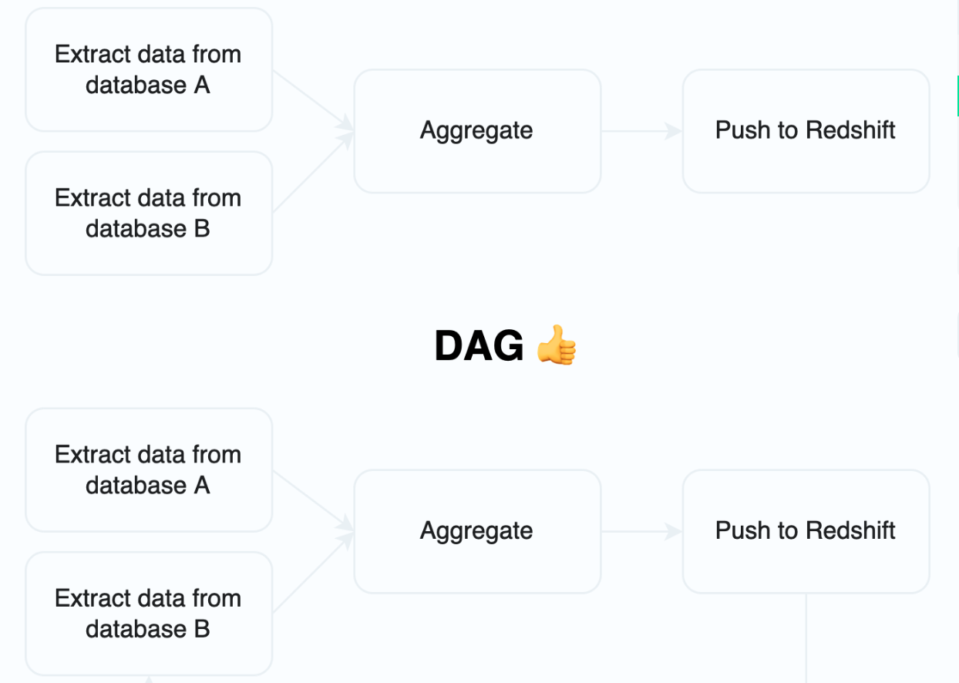
DAG Why give such a complicated name to this rather simple concept? It is because the main innovation with a DAG is that some tasks can depend on another in the workflow while others don't.
If a graph has a cyclic link then it is not a DAG. Having an acyclic graph is really useful to be sure your automation won't fall into a infinite loop, wasting resources. It is a really common and useful way of conceptualizing pipelines.

Slide 6
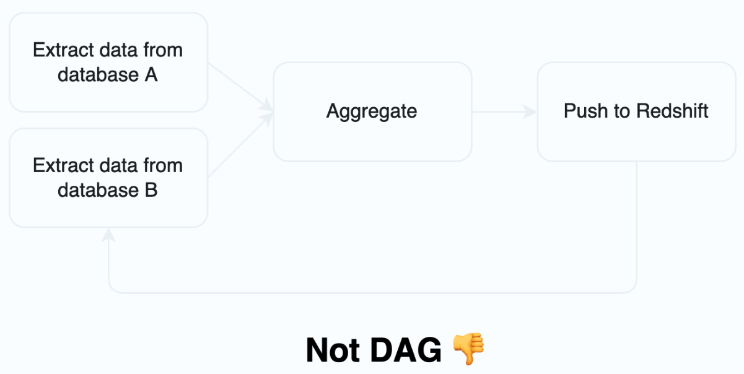
DAG

Slide 7
Operators
While a DAG describes a workflow, the operators are doing the actual work. In other words, an operator is a node in the schema above ☝️.
There are two types of operators:
Action operators: these are the ones that actually do the work. For example, the PythonOperator is an action operator.
Transfer operator: these are the ones that transfer data from one place to another. For example, the PostgresOperator is a transfer operator.
Sensor operator: these are the ones that monitor the state of the system. For example, the HttpOperator is a sensor operator.
You can find an operator for pretty much any cloud service or software you want to include. Check that list! Also it is possible to create your own operators, giving you the freedom to write endless solutions.

Slide 8
Tasks
Simply put a task is an instance of an operator.
Most of the time you can consider tasks and operators as the same thing. Simply put, a task is a specific use of an operator, where an operator is a template for a task.
In our DAG, a task corresponds to a node.
We can control how tasks are executed. There are two types of executions:
Sequential: the execution is sequential, meaning that the tasks are executed one after the other.
Parallel: the execution is parallel, meaning that the tasks are executed in parallel.

Slide 9
Passing data
Sometimes you want to pass some information from one task to another. There are two ways to achieve this.
XCom stands for cross communication. It is a way to pass information from one task to another using a key-value object.
It is not suitable for passing large amounts of data. Meaning you should not use it for passing a whole dataset or a whole database. This is not how Airflow works.
If you need to pass a large amount of data, you should use a database, or a file storage service like AWS S3. We will illustrate this later on during this module.
XCom is useful for small amount of data like metadata. That's all. But it is often useful!

Slide 10
Behind the scene
Let's review how Airflow is working internally. It will help us to understand how to use it.
In Airflow you have several entities working together:
the scheduler,
the executor/queue,
the queue,
the workers,
the webserver,
and the metastore!

Slide 11
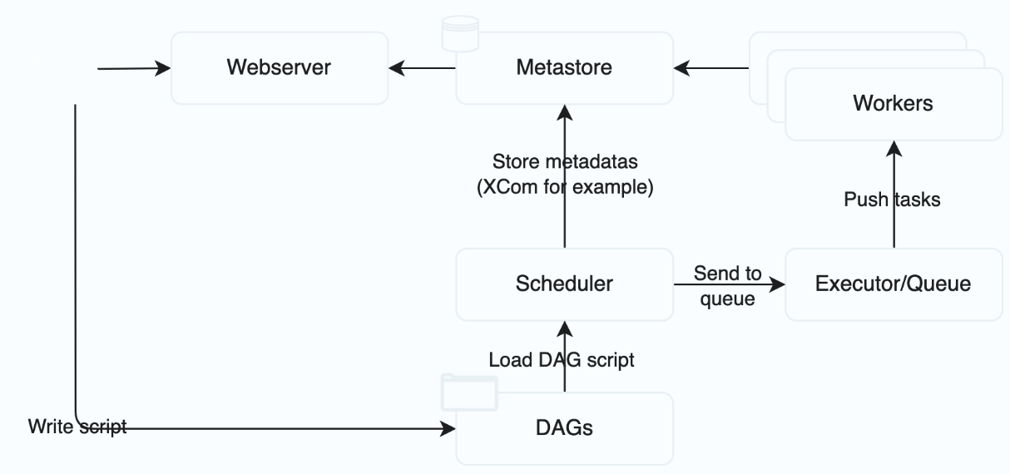
Behind the scene

Slide 12
Behind the scene
Scheduler
The scheduler is that the core of Airflow. It is thanks to it that Airflow knows when to run the tasks.
The scheduler is responsible for triggering and submitting a task to the executor.
You can see the scheduler as the process who check how our DAGs are going on, and supervise the execution of the tasks.

Slide 13
Behind the scene
Executor/queue
The executor is responsible for managing the tasks.
We will see later in this course that Airflow is able to manage several workers, that can run on different machines, either sequentially or in parallel.
The executor is often coupled with a queue, which is a way to stack the tasks. Those tasks will be consumed by the workers.

Slide 14
Behind the scene
Workers
A worker is a process that runs the tasks. A worker can be responsible for one or several tasks.
In Airflow you cannot plan which worker is going to execute which task. That is why we need to create a global execution environment.
To get its task, a worker pull one task from the queue.
The worker can store data in the metastore, which is a database.

Slide 15
Behind the scene
Metastore
Airflow needs a database to store the metadata of the tasks.
There are four databases available in Airflow:
PostgreSQL (recommended),
SQLite,
MySQL,
MsSQL.

Slide 16
Behind the scene
DAGs
It is the dags folder where you are going to put all your Python code.

Slide 17
Behind the scene
Webserver
Last but not least, Airflow provides a webserver to monitor and manage our DAGs.
It is the main interface we will use to interact with Airflow.

Slide 18
Behind the scene
Putting it together
Thus, to sum up, we have:
The user creates a DAG,
This DAG is read from the dags folder by the scheduler,
When the scheduler finds a DAG that needs to be run, it triggers the executor,
The executor manage tasks in a queue so as the workers can consume them,
Everything is connected to a metastore,
You are able to interact with the webserver to monitor and manage your DAGs.
That's pretty much it. We will discover along the way how we can configure those different entities in order to meet our expectations.

Slide 19
What Airflow is not
Just to bring more clarity, Airflow is not a data streaming solution like Kafka. It is not intended to be triggered in high frequency. Airflow is more suitable for batch processing.
Also, Airflow is not a data processing library. It is not like Pandas nor Spark. Airflow is an orchestrator, which means it handles the process of data processing and beyond!
Airflow is not what we call an Extract and Load solution for Extract-Load-Transform (ELT) pipelines. You know one of the best EL solution: Airbyte. Airbyte is a great solution to connect data sources. Airflow can do that but it does not possessed as much as connectors as Airbyte.

